Slide 1

Module 4(a)
Thermal analysis of Pb–Sn alloy
Presented by:
Vandana Kumari
PhD Scholar (20106287)
MSE Department, IIT Kanpur

Slide 2
Objective
To obtain thermal cooling curve of Pb-Sn alloy which has eutectic composition and find out its eutectic temperature.
Eutectic means easy to melt . Pb-Sn alloy is also known as solder alloy.
Pure metal and an alloy at eutectic composition freeze at a fixed temperature.
The eutectic temperature of the Pb-Sn eutectic is 183 ºC, where the temperature remained constant until all the liquid is transform into solid.
The eutectic composition of Pb-Sn alloy system is at 61.9wt% Sn.
Basic Equipments and requirements for experiment
Alumina Crucibles,
k type thermocouple,
furnace with PID controller ,
Temperature indicator,
Pb-Sn sample, etc.

Slide 3
Theory
Phase diagrams, also called equilibrium diagrams, are graphs that indicate the phases present at any temperature, with various compositions for a particular alloy system.
The phase diagram is in reality a chart which shows the relationship between the composition, temperature and structure of any alloy in a series.
The coordinate system of phase diagrams uses temperature as the ordinate scale and weight percentage of the alloy components as the abscissas.
The particular temperatures at which phase changes occur are plotted on this diagram for a given alloy composition, and when sufficient experimental points have been determined, lines representing the locii of all phase changes are drawn.
The phase diagram is valuable for determining the percentage amount of a particular phase in a two-phase structure, and it assists in understanding phenomena that occur during rapid heating and cooling.

Slide 4
Continued…….
Phase: It is a finite volume in the physical system within which the thermodynamic variables are uniformly constant; i.e., they do not experience any abrupt change in passing from one point in the volume to another.
Component: The complexity of a phase diagram is determined primarily by the number of components which occur in the system, where components are chemical species of fixed composition
Phases may be solids, liquids, or gases.
Gases are single-phase solutions and called homogeneous phases.
Liquids may be homogeneous and single phase or they may divide into regions of different composition and therefore be composed of two or more phases.
Solids may be single phase or may also be composed of more than one phase.
It is common to call a metal composed of more than one component i.e. an alloy.
Alloys may be single phase or multiphase. A single phase crystalline alloy consists of two or more components distributed randomly on a single crystal structure. Such single-phase alloys are called solid solutions.

Slide 5
Thermal Analysis
Thermal analysis is the simplest and most used technique.
By slowly heating or slowly cooling alloys of known composition while accurately measuring the temperature of the alloy at particular time intervals, plots are obtained which show the variation of temperature with time.
Any departure from a smooth curve is an indication of a phase change at the inflection temperature.
During the freezing of a pure metal, the latent heat of solidification which is liberated is exactly sufficient to maintain the alloy at constant temperature until freezing is complete.
A constant-temperature dwell appears in the cooling t curve. Latent heat liberated during the freezing of a solid-solution alloy is not sufficient to maintain constant temperature, but does decrease the rate of cooling.

Slide 6
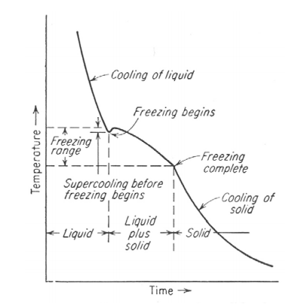
Continued…..
Cooling curve of a solid-solution alloy.
Discontinuous changes in slope of cooling curve indicate phase change.

Slide 7
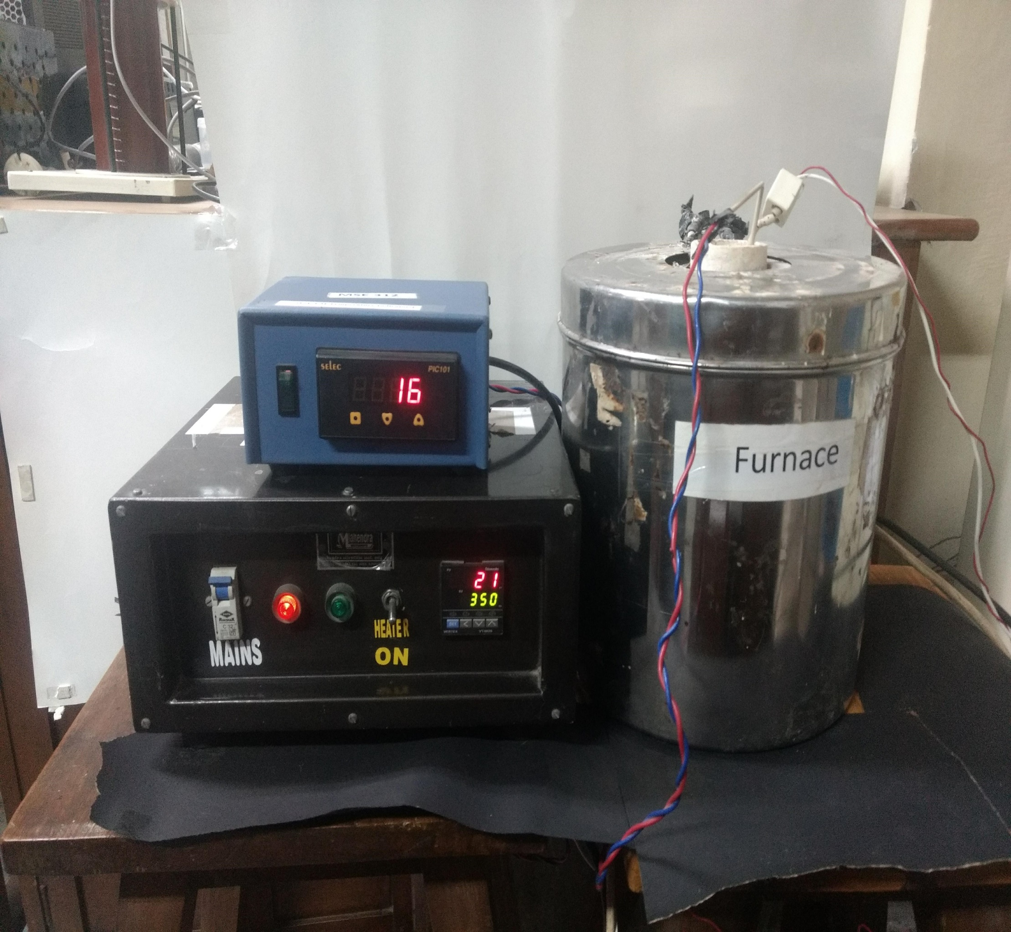
Experimental Set Up
Temp. Indicator
PID Temp. Controller

Slide 8
Introduction of furnace
A furnace is essentially a thermal enclosure and is employed to process raw materials at high temperatures both in solid state and liquid state
Main components of furnace
Source of energy
Suitable refractory material
Thermocouple
PID controller
Heating element

Slide 9

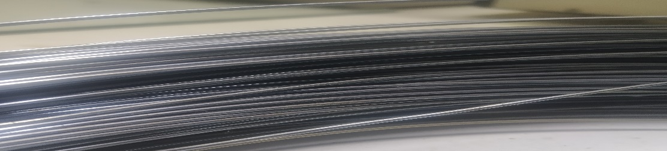


Heating Elements
Nichrome (Ni-Cr)
Kanthal (Fe-Cr-Al-Co)
Silicon carbide (SiC)
Super Kanthal (MoSi₂)

Slide 10
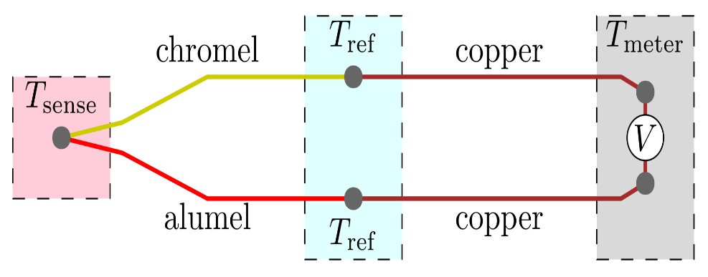

Physical Principle: Seebeck Effect
The See beck effect refers to an electromotive force whenever there is a temperature gradient in a conductive material.
Under open-circuit conditions where there is no internal current flow, the gradient of voltage, ΔV is directly proportional to the gradient in temperature Δ T.
ΔV = -S_{(T)} ΔT , where S_{(T)} is Seebeck coefficient.

Slide 11
Methodology
The molten alloy is kept in crucible in the centre of the furnace.
Immerse Chromel-Alumel thermocouple with protective sheath into the molten metal.
The current through the furnace is to be adjusted so that we will get 1 or 2 °c per min.
Temperature readings for every1 min has to be recorded using potentiometer. Be sure that you make any necessary reference junction corrections.

Slide 12
Eutectic Systems
There are different type of eutectic System such as; Pb-Sn, Cu-Ag, Bi-Sn, Fe-C
Pb-Sn Eutectic System

Slide 13
Copper Silver Eutectic Systems

Slide 14
Cooling Curve Of Pure Metal
BC: Plateaue or region of thermal arrest; in this region material is in the form of solid and liquid phases
CD: Solidification is completed, T drops

Slide 15
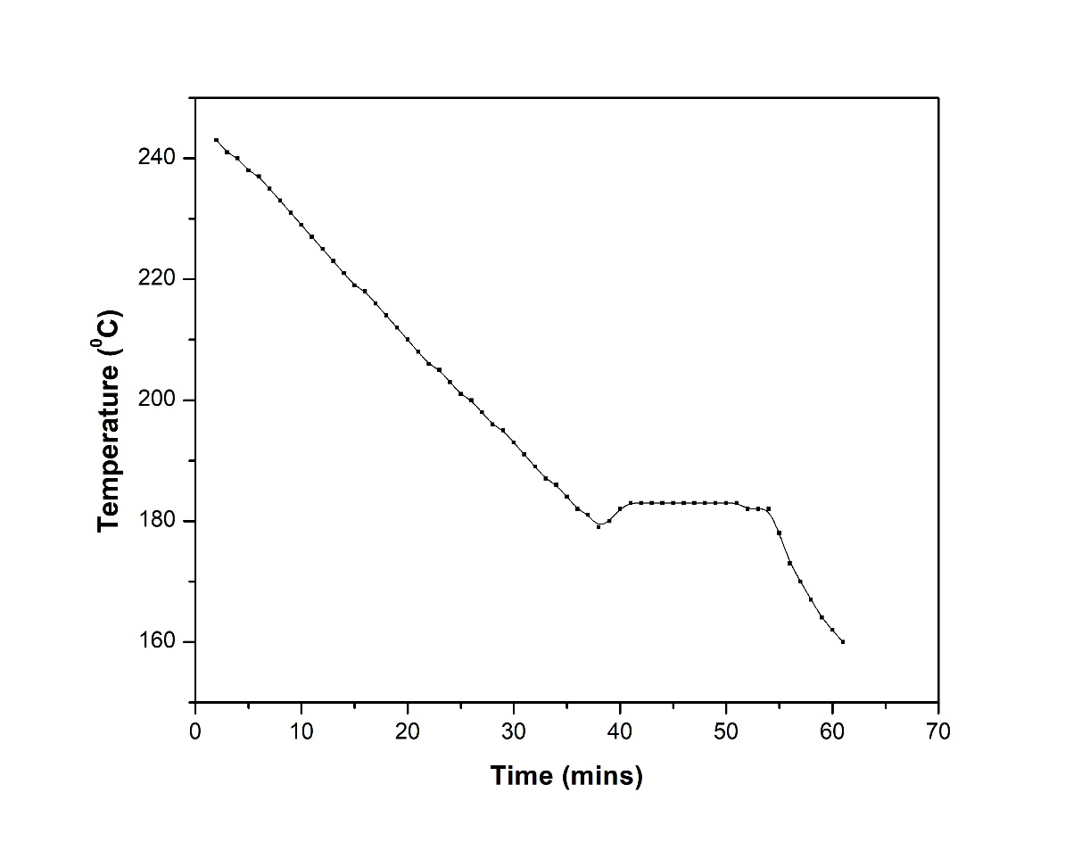
Experimental Cooling Curve of Pb-Sn Alloy
Pouring temp
A
A to B cooling of Liquid
Freezing Temp
B
C
B- beginning of solidification
C to D cooling of liquid Solidification is Complete
D
In form(B to C) of liquid & solid Phase

Slide 16
Microstructural changes as per the change in composition

Slide 17
Thank You!

